Slide 1
Transaction management
With examples

Slide 2
Imagine yourself being a data manager (DBMS)
You are receiving tasks from different clients (transactions).
These tasks include find pages (reads), do calculation, and write the results down (writes).
Some tasks are confirmed by your clients, so the results are put back (commit). Some tasks are not successful (abort).
If a task is canceled, you need to make sure to recover the original data.

Slide 3
You have two employees. They will do whatever you ask them to do.
Employee 1 is IO. His job is to find pages and bring you copies if that page is not in your office (memory), and put results back.
Employee 2 is CPU. He will do the calculation on the pages.
IO and CPU can do their jobs in parallel.
IO is slower than CPU
Your office (memory) is small, and can only hold a certain amount of pages at the same time. If a page is in your office, you can ask CPU to work on it immediately.

Slide 4
You received several clients (transactions) at the same time. T1, T2, T3
How to execute? (make a schedule)
Option 1: do it one by one.
Since these transactions arrived at the same time, you can decide the order. Your clients won’t complain
How many orders? n!
T1->T2->T3; T1->T3->T2
T2->T1->T3; T2->T3->T1
T3->T1->T2; T3->T2->T1

Slide 5
Problem of Serial Schedule
Idle time
For example, when IO is finding the page, CPU is waiting.
A short transaction could get stuck behind a long transaction

Slide 6
Serializable Schedule
You want to make schedules that allow interleave actions. Yet, the result is equivalent to one of the serial schedule (i.e. your client don’t notice you are serving other clients at the same time: isolation)

Slide 7
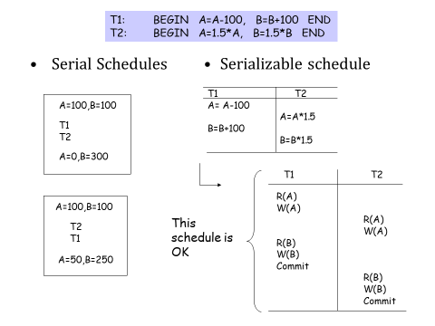
Example

Slide 8
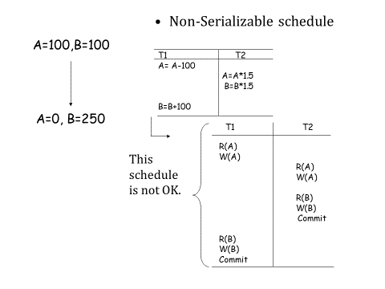

Slide 9
Anomalies
Though this schedule is OK, but it is risky
It can cause problem
T1 T2
R(A)
W(A)
R(A)
W(A)
R(B)
W(B)
Commit
R(B)
W(B)
Commit
This schedule is OK

Slide 10
T1 | T2
R(A)
W(A)
Client 1 came in and asked to update A’s value

Slide 11
T1 | T2
R(A)
W(A)
 | R(A)
 | W(A)
 | commit
When client 1 is thinking what he would do next, Client 2 came in, and you start to handle her transactions.
She asked you to update A’s value as well. Then she said “I am done” and left.

Slide 12
T1 | T2
R(A)
W(A)
 | R(A)
 | W(A)
 | commit
R(A)
Client 1 wanted to check if his update is correct
But he read client 2’s updated value.
“That’s not correct”, he said.

Slide 13
T1 | T2
R(A)
W(A)
 | R(A)
 | W(A)
 | commit
R(A)
abort
So he canceled his transaction.
Now you don’t know what to do. You suppose to reset A to its original value, but then you will lose client 2’s change. But you can’t cancel her transaction. You can’t ask her either, since she has left.
That’s a mess!

Slide 14
Write is a problem
You are trying to modify the page.
That’s going to affect other clients.
Abort is a problem
You need to undo actions

Slide 15
Solution 1
Once a transaction reads a value, then before it commits/aborts, no other transactions are allowed to write the value;
Once a transaction writes a value, then before it commits or aborts, no other transactions are allowed to read or write the value
This is a strict schedule!
Serial schedule is always strict schedule

Slide 16
Solution 2
You can ask your client: Can you tell me what would you like to do for your transaction?

Slide 17
Conflict Equivalent
Same actions of the same transactions.
Every pair of conflicting actions of two committed transactions is ordered the same way
T1 T2
T1 T2
R(A)
W(A)
R(B)
W(B)
Commit
R(A)
W(A)
R(B)
W(B)
Commit
R(A)
W(A)
R(A)
W(A)
R(B)
W(B)
Commit
R(B)
W(B)
Commit

Slide 18
Precedence Graph (Serializability Graph)
The precedence graph for a schedule S contains:
A node for each committed transaction in S
An arc from Ti to Tj if an action of Ti precedes and conflicts with one of Tj ’s actions
T1 T2 T3
R(A)
W(A)
Commit
W(A)
Commit
W(A)
Commit
T3
T1
T2
Cycle →Not conflict serializable!
Theorem: A schedule is conflict serializable if and only if its dependency graph is acyclic

Slide 19
T1 | T2
R(A)
W(A)
 | R(A)
 | W(A)
 | commit
R(A)
commit
T1 | T2
R(A)
W(A)
 | R(A)
R(A)
commit
 | W(A)
 | commit

